Slide 1
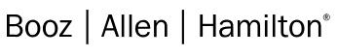
Device Driver Debauchery and MSR Madness
Ryan Warns and Tim Harrison

Slide 2
Outline
Introduction
Device Drivers and You
Architecture
Assessing
Model Specific Registers (MSRs)
Normal System Usage
Normal Application Usage
The Bug(s)
Execution/Payload issues
Conclusion & Recommendations

Slide 3
Introduction

Slide 4

whoami.exe
Ryan Warns
Staff Reverse Engineer, FLARE OTF team
Career trajectory:
Reversed malware
Wrote malware
Reversed malware
???
Fun fact: met fiancé on Counter-Strike
Also almost broke up with fiancé because of Counter-Strike ☺
Likes Windows Internals, Binary Exploitation, and long walks on the beach
@NOPAndRoll

Slide 5
whoami.exe
Tim Harrison
BS Comp Sci
Lead Technologist, Booz Allen Hamilton
Reverse Malware
Red Teaming
Driver development
Fun fact: Likes SCUBA diving, especially wrecks
Likes exploitation, expansion of access

Slide 6
Motivation
Device Drivers are all around us
Commonly distributed as part of software packages
Process explorer, procmon, etc, all have drivers
Commonly escape rigorous testing
Testing from Microsoft mostly automatic
Assumptions about how they’re being used (GUIs et al)
A bug in one driver leads to total system compromise
Unique post-exploitation issues
It’s cool ☺
Notes:
Unique post-exploitation issues -> will talk about later

Slide 7
Motivation
Some malware families use device drivers to escalate privileges
VirtualBox
Device Drivers already present in some Red Team toolkits
Mimikatz uses a driver (mimidrv.sys) to facilitate injection
Even if the application isn’t installed you can carry the driver
Keep it on the DL – Drop & Load
Requires Admin privileges
Many* don’t consider admin-to-Ring-0 a security boundary
We do though ☺
Notes:
Todo need the specifical virtualbox CVE
One of the things we’ll discuss throughout the talk is that having administrator access to communicate with a device object is not (or should not) be sufficient as a security boundary. During any other Red Team assessment you have levels of bugs and issues which you report. Vulnerabilities such as this should be no different – it’s obviously worse if the device object allows unrestricted access and results in Ring-0 execution, but even if administrator access is requiring being able to abuse one of these drivers for Ring-0 exec can still lead to bypassing security products, installing rootkits, etc, without alert the user, rebooting, or modifying system settings

Slide 8
Device Drivers And You

Slide 9
Device Drivers And You
Most drivers on Windows are tied to hardware
Plug And Play (PnP)
Filter Drivers
Software drivers are not tied to hardware and manage system resources
These drivers manage resources not exposed to user-mode
Or in a way not exposed to user-mode
Device Driver defines/configures who can talk to it
Not the OS
Required permissions, handshake, etc
Notes:
Todo need the specifical virtualbox CVE

Slide 10
Device Drivers And You - Communication
Driver communication primarily done through I/O Request Packets (IRPs)
Microsoft uses 28 IRP codes to track different I/O Transactions
IRP_MJ_CREATE – Opening an object
IRP_MJ_READ/IRP_MJ_WRITE – reading and writing to an object
IRP_MJ_DEVICE_CONTROL – driver-defined control codes used with DeviceIoControl()
IRP-handling functions are your first entry points for fuzzing
And really only IRP_MJ_DEVICE_CONTROL
Notes:
IRPs are data structures the operating system uses to track a particular transaction
These IRPs are examples

Slide 11
Device Driver Communication – Putting it all together
FILE_OBJECT
DEVICE_OBJECT
DRIVER_OBJECT
FUZZ HERE
HANDLE
Kernel Mode
User Mode
CreateFile

Slide 12
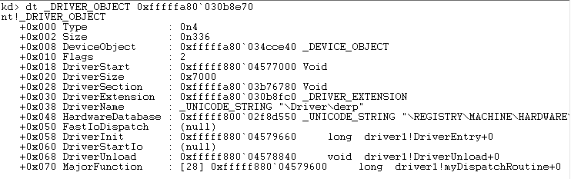
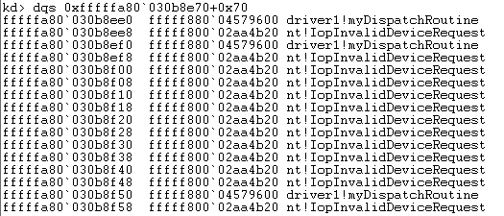
Device Drivers And You - windbg
IRP_MJ_CREATE
IRP_MJ_CLOSE
IRP_MJ_DEVICE_CONTROL
Notes:
Driver’s responsibility to populate the function table. Function pointers that are not overwritten have a default routine that returns STATUS_NOT_SUPPORTED
In this case they’re all set to the same thing, which is common

Slide 13
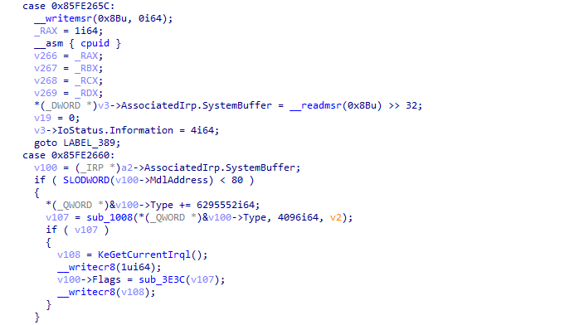
DeviceIoControl – the back end
Notes:
These codes match what was shown on the previous slide

Slide 14
Common Device Driver Issues
Improper access to DEVICE_OBJECT
Administrator access
Think: “Should an administrator be able to disable endpoint protection?”
Not validating input
User-mode pointers particularly – ProbeForRead/ProbeForWrite
Direct I/O
The usual sampling of bugs in protocols
Signed/unsigned integers
Length-value
Malformed structures
WoW issues
Notes:
We are skipping over 99% of IRP handling code for simplicity
Most of these drivers used buffered I/O, where the OS copies the user-mode input in a safe way (based on the parameters to DeviceIoControl) on the way in, the dispatch routine does whatever, and any data in that buffer is copied out by the OS after the dispatch returns
Physical memory access in particular

Slide 15
Model Specific Registers (MSRs)

Slide 16
Model-Specific Registers
Model-Specific Registers (MSRs) are registers for toggling/querying CPU info
Vendor-specific
Model-specific
Contains registers to:
Monitor system performance
Perform branch tracing
Handle system calls
Handle system calls
Handle system calls
Access via the rdmsr and wrmsr instructions
Only accessible in Ring-0
AKA a driver
Notes:
We are skipping over 99% of IRP handling code for simplicity
Most of these drivers used buffered I/O, where the OS copies the user-mode input in a safe way (based on the parameters to DeviceIoControl) on the way in, the dispatch routine does whatever, and any data in that buffer is copied out by the OS after the dispatch returns

Slide 17
Life of a Windows API Call – CreateFileA
kernel32.CreateFileA
KernelBase.CreateFileA
KernelBase.CreateFileW
SYSCALL/SYSENTER
KernelBase.CreateFileInternal
ntdll.NtCreateFile
Transition to kernel mode

Slide 18
Model-Specific Registers
The transition to kernel-mode is done via an MSR
syscall -> read MSR -> call MSR pointer (Ring-0) -> kernel function handles the syscall logic
Multiple MSRs may be consulted during the transition
MSR_STAR - 0xC0000081
MSR_LSTAR - 0xC0000082
MSR_CSTAR - 0xC0000083
IA32_SYSENTER_CS - 0x174
IA32_SYSENTER_ESP - 0x175
IA32_SYSENTER_EIP - 0x176
Default on modern systems we only care about MSR_LSTAR
Can inspect via rdmsr command in windbg
Notes:
OS sets the proper syscall handler(s) early in the boot process
These MSRs were used by rootkits in the days of yore to modify system behavior
PatchGuard

Slide 19
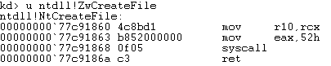
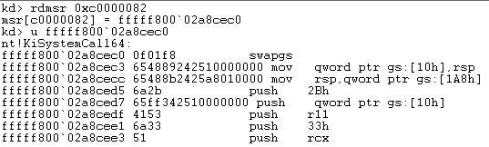
Model-Specific Registers
MSR_LSTAR
Notes:
This is the default transition. Other MSRs used on other CPUs/for compatibility or legacy modes

Slide 20
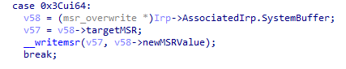
Spot the Problem
You can probably see where this is going
Exposed wrmsr (__writemsr) instruction gives us a pointer overwrite primitive
Function pointer is called when any syscall is issued
Called from Ring-0 ☺

Slide 21
How Bad Is It, Really?
This exact issue was found in over 20 drivers
Some of them mentioned in previous research
Multiple bugs (physical memory access in particular)
In many cases didn’t need to change the payload at all, just the IOCTL values and device driver names

Slide 22
How Bad Is It, Really?
At a glance:
20+ drivers
In the 100s of millions of affected downloads
Multiple (3) default installed at one time on major hardware vendors
~14 drivers used the same input format (just change IOCTL number)
Less than half required admin access to communicate with the driver
1 was fixed by the time we reported ☹
1 attempted to filter MSR access
But failed due to an integer overflow ☺

Slide 23
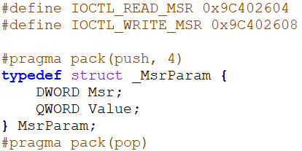
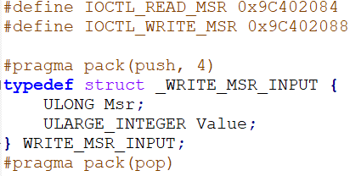
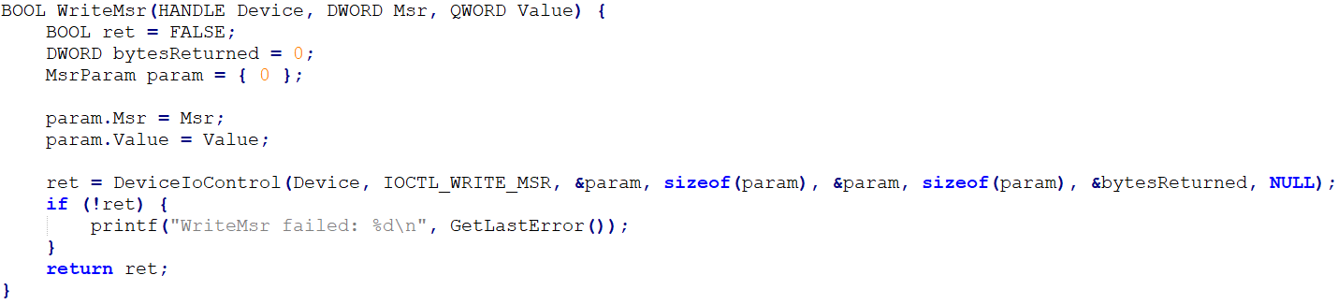
How Bad Is It, Really?

Slide 24
How Bad Is It, Really?
Products affected:
System monitoring software
“Device Control” software
Overclocking software
Some worse than others
Some MSRs filtered
DEVICE_OBJECT permission
Multiple vendors asked if requiring administrator rights was a fix
Notes:
In the 100s of millions of boxes in terms of exposure – GPU-Z alone was ~50 million downloads. PC Doctor was default-installed on Dell systems and is still linked to HP Support for a long time
2 drivers were filtering the 32-bit syscalls
1 driver filtered all of them, but had another bug in it so it didn’t matter

Slide 25
How Bad Is It, Really?
Several drivers only exposed the wrmsr IOCTL if the caller had admin rights
Is Admin-> System a strong security boundary?
In any other engagement bugs/issues are ranked on severity
CVE score as well
APT actors already using signed driver exploits as part of their campaigns
Slingshot
Signed drivers are forever
Notes:
The Sandra driver was a driver which we originally wanted to report but was dropped during the Kaspersky report
Administrator access can technical do anything, but things like disabling DSE, installing a rootkit, etc, are done with visible effects on the target system. Just running an exploit has none of these
Could have a security product look for specific vulnerable files

Slide 26
Exploitation and Stabilization

Slide 27
Kernel Shellcode
All kernel LPEs require special care when crafting shellcode
Any instability = BSOD
May be in weird execution scenarios
Notes:
Recall that the function pointer in the MSR is called immediately when a syscall instruction happens. The transition to kernel-mode has not been setup at all. This is different than, say, a vanilla buffer overflow in a device driver because the OS would have set up all the glue bits by then
Most RT priv escs only worry about grabbing tokens. This is fine but it also means that you can have an exploit that isn’t as stable but still works. Loading a driver involves doing a lot of stuff such as memory allocations and etc

Slide 28
Kernel Shellcode
These bugs provide extra flavor when creating a functional exploit
Kernel-mode not setup/fully transitioned into (Arbitrary pointer called in Ring-0)
Each logical processor has its own copy of each MSR
Need to worry about SMEP
Need to worry about KPTI
Need to return out of kernel-mode without crashing the system
Honorable mention: debugging in a VM
Notes:
Recall that the function pointer in the MSR is called immediately when a syscall instruction happens. The transition to kernel-mode has not been setup at all. This is different than, say, a vanilla buffer overflow in a device driver because the OS would have set up all the glue bits by then
Most RT priv escs only worry about grabbing tokens. This is fine but it also means that you can have an exploit that isn’t as stable but still works. Loading a driver involves doing a lot of stuff such as memory allocations and etc

Slide 29
Kernel Shellcode
Most PoCs stop at “give me the system token”
I want it all
Reflective driver loading requires a more stable exploit
Will need to solve all of the above issues
Notes:
Recall that the function pointer in the MSR is called immediately when a syscall instruction happens. The transition to kernel-mode has not been setup at all. This is different than, say, a vanilla buffer overflow in a device driver because the OS would have set up all the glue bits by then
Most RT priv escs only worry about grabbing tokens. This is fine but it also means that you can have an exploit that isn’t as stable but still works. Loading a driver involves doing a lot of stuff such as memory allocations and etc

Slide 30
Baby Steps
For a Win7 x64 system we don’t need to worry about any system protections
So only ~half of the problems
Once the MSR is overwritten our pointer is called in Ring-0
Not kernel-mode

Slide 31
Baby Steps
Problems we need to address for Win7:
We’re not in kernel-mode – what can we do and not do?
MSRs are shared per processor – what happens if someone else makes a syscall?
How do we get back to user-mode? Our payload needs to act as a proper syscall handler
Where do we put our code?

Slide 32
Dude, Where’s My Pointer?
We’re exploiting these bugs via IOCTL
The syscall handler runs in the context of our process
Where do we put our payloads?
Virtual Memory
What is not accessible if our process is switched off the processor?
Virtual Memory
What happens if another process runs a syscall before we finish our exploit?
Like finding buried treasure, but the opposite
What happens if our payload VA gets paged out before we’re done?
Like finding buried treasure, but the opposite
Notes:
Virtual Memory refresher:
If I allocate a piece of memory with VirtualAlloc the address that is returned to me is only valid for my process
If another process is context-switched onto the CPU that address either has bad data, or is unmapped
If another process makes a syscall while the MSR value is a virtual address that’s only valid in the exploiting process, the system will crash
Process context on windows includes the current virtual memory map/list/etc
If another process tries to make a system call the CPU will try to execute the virtual address specified by the MSR and will crash

Slide 33
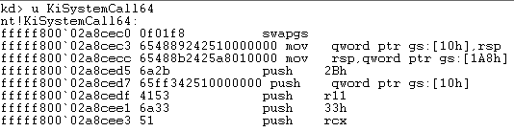
Smuggling Ourselves In And Out of Kernel-Mode
“How do I know what to do to transition to kernel-mode?”
Consult KiSystemCall64 ☺
Notes:
swapgs exchanges the current GS value with the value set in the IA32_KERNEL_GS_BASE MSR
sysretq is used to return to long mode (RIP from RCX and RFLAGS from R11)

Slide 34
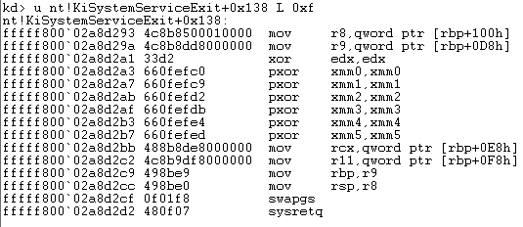
Smuggling Ourselves In And Out of Kernel-Mode
How do I know what to do to transition out of kernel-mode?
Consult KiSystemExit ☺
Notes:
swapgs exchanges the current GS value with the value set in the IA32_KERNEL_GS_BASE MSR
sysretq is used to return to long mode (RIP from RCX and RFLAGS from R11)

Slide 35
Taking Turns Like Kindergarten
Our payload:
Needs to be the only one running while the target MSR is corrupted
Must not be switched off in the middle of our execution
Needs to keep running on the same processor the entire time
Combination of three APIs to solve all of our problems:
Sleep before we execute
SetThreadPriority
SetProcessorAffinity
Notes:
Needs to be the only one running while the target MSR is corrupted -> Prevents other processes from calling a syscall on a bad virtual address
Not to be switched off -> Stops our user-mode process from assuming the export has fired when it hasn’t
Some of this is likely overkill, especially from a PoC perspective, but

Slide 36
Taking Turns Like Kindergarten
SetProcessorAffinity – specifies what processors a thread runs on
MSRs are per logical processor
Sleep – Ensures we run with the maximum time quantum possible
SetThreadPriority - Makes it less likely that our thread will be switched off
Notes:
Needs to be the only one running while the target MSR is corrupted -> Prevents other processes from calling a syscall on a bad virtual address
Not to be switched off -> Stops our user-mode process from assuming the export has fired when it hasn’t
Some of this is likely overkill, especially from a PoC perspective, but

Slide 37
Smuggling Ourselves In And Out of Kernel-Mode
No registers are changed when the CPU executes the syscall instruction
Except RIP, RCX, R11
Stack still user-mode
Remaining registers the same
We need to transition to kernel mode fully so our payload will actually run
E.g. can’t run kernel APIs with an arbitrary user-mode pointer
We need to transition out correctly so we don’t crash the system
Continuation of execution
The swapgs instruction runs at the entry and exit point
This instruction should be the first thing we execute
swapgs exchanges the current GS with the one in the IA32_KERNEL_GS_BASE MSR
Usermode: GS points to TEB, Kernelmode: GS points to KPCR for processor
Notes:
None of the lazy things (e.g. exiting a thread) will work for our payload because of the context in which we are running

Slide 38
Windows 7 Shellcode
SWAPGS and Stack setup
Kernel shellcode
swapgs # sysretq
Notes:
Todo -> picture showing payload so far. Payload has swapgs

Slide 39
SMEP SCHMEP
Previously slides described execution on Win7 x64
Slingshot only supported pre-Windows 8
aka EZMODE
Execution on Win8+ requires previous steps plus getting around SMEP
Supervisor Mode Execution Prevention - BSODs if CPU detects execution of a user-mode VA while in Ring-0
Meaning we can’t just call our shellcode directly as before

Slide 40
SMEP SCHMEP
Like DEP, bypassing SMEP is done via Return Oriented Programming
You know it’s correct because it rhymes
ROP is done via gadgets
Small pieces of executable code ending in a RET instruction
Form a chain of these together to accomplish a goal
We’re going to have to be a little trickier

Slide 41
Getting Our Ducks In A Row
Finding ROP gadgets is easier for Local Privilege Escalations than RCE
EnumDeviceDrivers can be used to query where drivers are in kernel space
LoadLibraryEx can be used to load the PE files into user space
Finding ROP gadgets:
LoadLibraryEx on a kernel binary -> Get usermode base
Search user-mode memory for gadgets at your leisure
Use EnumDeviceDrivers to get the kernel address of that binary
Use the difference in base addresses to calculate where the ROP gadget is in kernel-mode
GG
Notes:
Now we can write an algorithm to do more generic searching for gadgets
So what are we looking for?

Slide 42
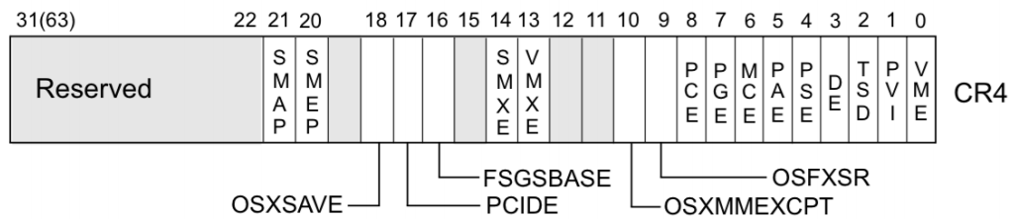
Getting Our Ducks In A Row
SMEP is enabled via the CR4 register
Goal of our ROP chain is to either:
Modify CR4 to mask off the SMEP bit
Copy our shellcode into NonPagedPool executable (kernel) memory and run it from there
We’re going with the modify CR4 method
Notes:
We’re using a CR4 ROP chain for this exploit – calling ExAllocatePool for sufficiently large payloads during the ROP chain can cause the system to crash

Slide 43
Getting Our Ducks In A Row
We could use ExAllocatePool to allocate executable kernel code
Run our shellcode from there
This option has issues with sufficiently large payloads
When done during ROP
CR4 is more straightforward
CR4 bits change based on processor functionality
Don’t want to flip arbitrary bits
We can use cpuid to query all the right flags
Notes:
We’re using a CR4 ROP chain for this exploit – calling ExAllocatePool for sufficiently large payloads during the ROP chain can cause the system to crash

Slide 44
Let’s ROP and Roll
We immediately have a problem with our ROP chain
In Win7 land the first instruction that we execute is swapgs
Bad news: finding a swapgs/ret gadget is almost impossible (reliably)
Presented with two problems:
We need to be able to find a different way to run a swapgs gadget
Generally we need flexibility when a particular gadget isn’t found on a particular OS/version

Slide 45
Let’s ROP and Roll
We need to find a usable gadget with swapgs early in our ROP chain
To make our lives easier ☺
No swapgs # ret combo
What about other returns?
Already saw sysretq previously, but that returns us to Ring-3
What about RET N gadgets?
More distance between swapgs and ret is possible, but adds risk
Others?
Notes:
Adding bytes between ROP gadgets is less reliable

Slide 46

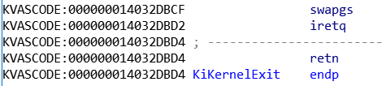
Let’s ROP and Roll
Notes:
Need to animate this – you get the idea

Slide 47
Let’s ROP and Roll
This swapgs/iretq gadget is consistent across OS versions
The iretd/q instruction is normally used to return from an interrupt
But it doesn’t have to
iretd/q takes the return address, stack pointer, code and stack segment, and RFLAGS on the stack
Like a RET with parameters
If we set up our stack we can use it as if it were a regular ROP chain
CS is normally 0x10 for kernel-mode
SS is normally 0x18 for kernel-mode
Keep interrupts DISABLED in RFLAGS
Notes:
Picture?

Slide 48
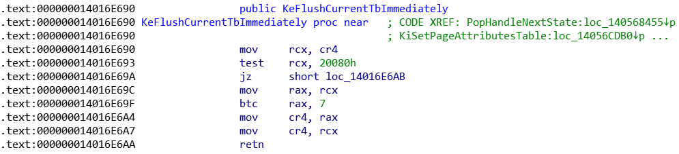
Let’s ROP and Roll
Next we disable SMEP by toggling the bit in CR4
Finding a mov cr4 gadget is pretty easy
Notes:
The second option for CR4 is better – there are less gadgets we need to worry about calculating, and it allows us to restore things properly

Slide 49
SMEP payload
User-mode code calculates new CR4
Instead of trying to do it via ROP
swapgs # iretq
Modify CR4 gadget
Kernel shellcode
swapgs # sysretq
Notes:
The second option for CR4 is better – there are less gadgets we need to worry about calculating, and it allows us to restore things properly

Slide 50
When It Rains It Pours
As a response to Spectre and Meltdown Microsoft added Kernel Page Table Isolation (KPTI)
KPTI maintains a separate set of page tables for user- and kernel-mode
The CR3 register contains the base of the current set of page tables
While in user-mode, you have a user-mode CR3 value (KPROCESS.UserDirectoryTableBase)
While in kernel-mode, you have a kernel-mode CR3 value (KPROCESS.DirectoryTableBase)
Notes:
Previously kernel virtual addresses were mapped into all user-mode

Slide 51
When It Rains It Pours
KPTI implementation is also changing per-version
Call NtQuerySystemInformation
SystemSpeculationControlInformation to determine KPTI status
This is documented by Microsoft
Notes:
Previously kernel virtual addresses were mapped into all user-mode

Slide 52
ROP and Roll 2: Electric Boogaloo
When user-mode code is executing there are very few valid pages of kernel-mode code
Just enough to handle transitions in and out of the kernel
Section named KVASCODE in ntoskrnl.exe
New handlers for kernel entry: *Shadow (such as KiSystemServiceShadow)
When a kernel transition happens the handler loads the process’ kernel CR3 value
Jumps to the original handler (such as KiSystemService) or implements it

Slide 53
ROP and Roll 2: Electric Boogaloo
This means we need to find a few new things to defeat KPTI:
Kernel-mode CR3 value for our process
A ROP gadget, located in the KVASCODE section of ntoskrnl.exe, that will modify CR3
This is only one or two pages of code to find gadgets in

Slide 54
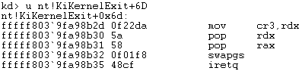
ROP and Roll 2: Electric Boogaloo
Finding gadgets to modify CR3 is easy enough
The kernel has to implement this shortly before a return to user-mode code
Windows 10 1709/1803:
Notes:
1709/1803 is a 2-for-1

Slide 55
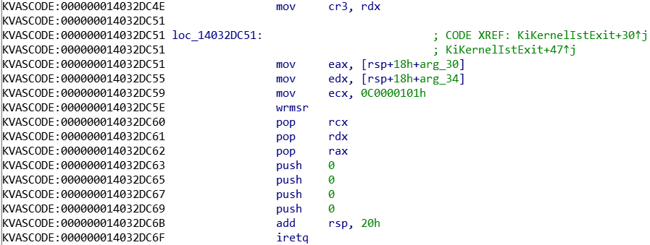
ROP and Roll 2: Electric Boogaloo
Finding gadgets to modify CR3 is easy enough
Windows 10 1809:
Notes:
1709/1803 is a 2-for-1

Slide 56
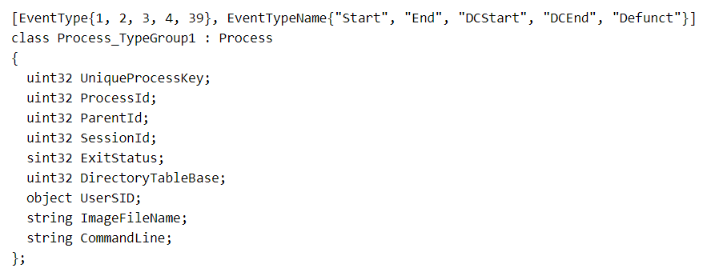
ROP and Roll 2: Electric Boogaloo
We’ll need to know the kernel CR3 value for our process ahead of time
No usable gadgets to find and load the real one
Solution: Kernel ETW Provider Leaks
Alex Ionescu Recon 2013 presentation “I Got 99 Problems But a Kernel Pointer Ain’t One”
Process_TypeGroup1
DirectoryTableBase
Notes:
1709/1803 is a 2-for-1

Slide 57
Full ROP chain, Windows 10 1809
Notes:
Picture

Slide 58
KPTI payload
User-mode code calculates new CR4
Instead of trying to do it via ROP
User-mode code finds kernel CR3
swapgs # iretq
Modify CR3 gadget
Modify CR4 gadget
Kernel shellcode
swapgs # sysretq

Slide 59
Payload Considerations – All Versions
Now that we have a reliable ROP chain to give us execution
Across all versions for maximum reliability we need to:
Restore the real MSR as early as possible
Restore CR4 as soon as our payload is done
PatchGuard checks both of these
Using raw assembly for IOCTLs and syscalls reduces the race condition
Don’t call ExAllocatePool until we’re back in a normal state
Page faults et al are bad until we’re in “real” kernel land
Notes:
Our payload has a small shellcode stub which calls ExAllocatePool to copy the full payload buffer

Slide 60
Payload Considerations – All Versions
Where do we put our ROP chain?
Easy: Keep using the usermode stack
Medium: Copy to .data section of vulnerable driver and ROP from there
Hard: Kernel stack spray using NtMapUserPhysicalPages
Turns out Easy is good enough
Notes:
Our payload has a small shellcode stub which calls ExAllocatePool to copy the full payload buffer

Slide 61
Current and Potential Mitigations
HyperV will catch the attempt to modify MSRs and will stop it
It would also catch the attempt to modify CR3/CR4 if we could get that far
PatchGuard catches MSR and CR3/CR4 modifications
Only if the checks run mid-exploit, though
Adding some sort of cookie check post-CR3 restoration could raise the bar
Require attackers to also have arbitrary kernel reads
More driver install notifications
Hardware drivers have confirmation prompts on install – but not software drivers?
Change ETW leak to return UserDIrectoryTableBase instead

Slide 62
Demo

Slide 63
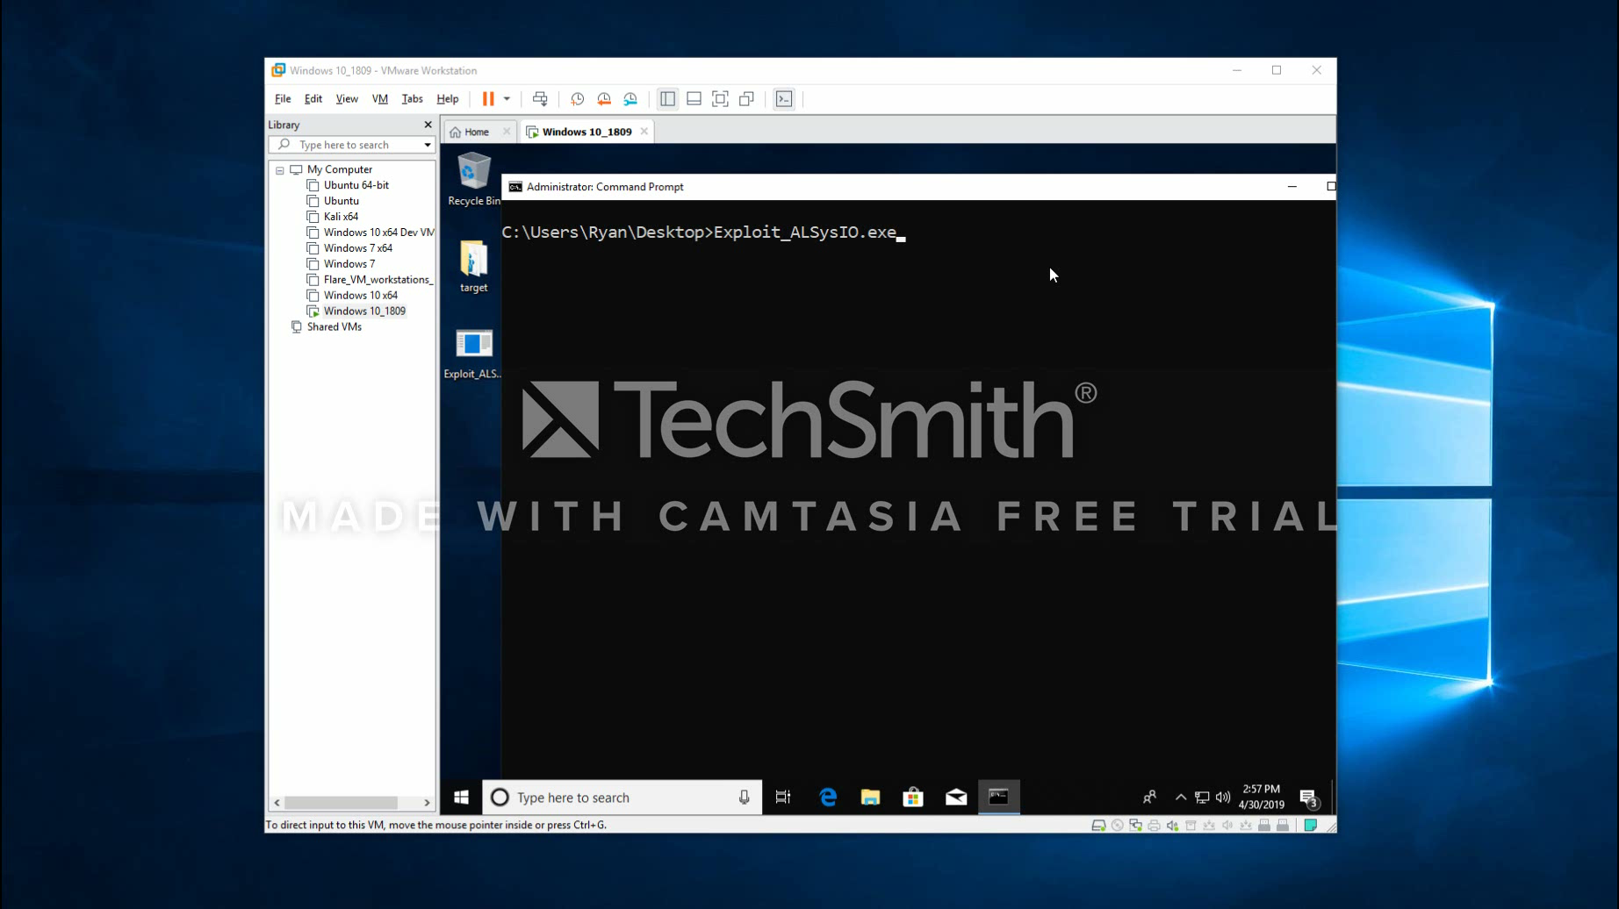
Notes:
Suggested demo script:
We’re going to do something a little more involved than just showing a whoami demo and a token swap.
This demo is going to walk through all the steps of exploiting on a current up to date 1809 system
(As the user mode print stuff pops up) Here you can see we’ve calculated as much in user mode as we can – we’ve resolved kernel pointers we need for our exploit, found our CR3 and CR4 gadgets in the KVASCODE section, and we’ve queried the original MSR value we’re overwriting
(As the C code comes up) Where we’re currently broken we’ve already gone through the user-mode steps to avoid race conditions by locking our memory and tweak priorities to keep us running
(Back in windbg) Here we’re about to trigger the exploit. We’ve constructed a shellcode buffer to overwrite the MSR and do the syscall. You can see that the LSTAR MSR is already overwritten with our swapgs register
The next step in our chain is to mitigate KPTI by replacing the CR3 value with the one we got from our ETW leak. This gadget also has a wrmsr instruction in it but we can query that value ahead of time so it’s not a problem
I’ll step through this and you’ll see that we’ll eventually make it to our CR4 gadget. We also had to build a modified ROP stack for this since we’re using an iretq
You can see the flag is toggled for CR4
Now we need to allocate our final payload. Once CR4 is off we can execute in user-mode code without an issue, then we use ExAllocatePool to create a buffer of executable kernel code which we’re going to call later
This is the buffer that’s going to have our final payload. IN this case we have a reflective driver loading payload. We get called as part of the HAL Dispatch Table from NtQueryIntervalProfile
Everything after this is just PE loading code with some spice but you can see with this .reload command that we have a test sys file correctly loaded and executing in Ring 0 space
And we didn’t crash ☺
We previously talked about how easy it is to port this exploit across different products – the CPP code shown here is all the code necessary for one particular binary. We just need to change the IOCTL numbers and the device name and we’re good to go. Most of the binaries use this same struct for DeviceIoControl so we don’t need to do anything for that

Slide 64
Conclusion

Slide 65
In Conclusion
Issues in Device Drivers are common
Productizing can be tricky…
But not impossible
Single point of failure
Total system compromise
Because of this vendors need to be diligent in their testing
Least privilege: administrator access isn’t sufficient
Diamonds Signed driver issues are forever
Certificate revocations are rare
Best defenders can hope for are updates and signatures on existing drivers

Slide 66
Recommendations for Developers
Properly validate who can access your DEVICE_OBJECT
IoCreateDeviceSecure and friends
Custom logic in IRP_MJ_CREATE
Filter access to MSRs
Security heuristics to check for known bad signed drivers

Slide 67
FIN
Questions?

